Slide 1


Department of Computer Science and Engineering
ROUTE OPTIMIZATION FOR EMERGENCY VEHICLES
by
Sindhumathi.B - 2019PECCS186(2114119104253)
Sneha.V - 2019PECCS190(211419104258)
Sneka.R - 2019PECCS191(211419104259)
GUIDED BY,
Mrs.K.Valarmathi ME,Phd
CO-ORDINATOR,
Mrs.K.Valarmathi ME,Phd

Slide 2
INTRODUCTION
In this modern era approximately 60% of the people get struck in the traffic in their day-to-day life which results in major problems.
To introduce an algorithm that preciously finds the shortest path and guide the emergency vehicle to reach the destination at faster rate.
The solution helps not only emergency vehicle but also the common people who wishes to reach their destination on time.

Slide 3
LITERATURE SURVEY
Year | Title | Author | Methodology Used
February 2023 | Traffic flow prediction using machine learning and deep learning. | Muhammad Aqib ORCID, Rashid Mehmood, Ahmed Alzahrani, Iyad Katib, Aiiad Albeshri and Saleh M. Altowaijri. | The use of machine learning (ML) and deep learning (DL) in order to improve traffic flow forecasting and prediction.
May 2022 | Real-Time Dynamic Route Optimization Based on Predictive Control Principle | Zhanzhong wang and Shuoqi wang | The most important feature of the model algorithm is that it takes the static driving route and desired driving time as the control goals.
May 2021 | IoT-based traffic prediction and traffic signal control system for smart city. | Neelakandan Subramani, M. A. Berlin, Sandesh Tripathi, V.Brindha Devi | The OWENN algorithm, Intel 80,286 microprocessor, and five stages of data collection in order to reduce traffic congestion.
October 2020 | IoT security with Deep Learning-based Intrusion Detection Systems. | Idrissi, M. Azizi and O. Moussaoui | This system has been developed to help protect against security threats and researchers are looking into ways to integrate the system into real network traffic to help detect cyber attacks.
December 2020 | KCLP: A k-Means Cluster-Based Location Privacy Protection Scheme in WSNs for IoT. | G. Han, H. Wang, M. Guizani, S. Chan and W. Zhang | K-Means Cluster-Based Location Privacy Protection Scheme in WSNs for IoT, designed to reduce the problems associated with wireless sensor networks.

Slide 4
PROBLEM STATEMENT
Due to heavy traffic congestion, most of the patients who are travelling on an emergency vehicles like ambulance, get struck in the traffic.
In order to prevent this critical situation an solution has been deployed to detect and prevent the traffic flow specifically for emergency vehicles.

Slide 5
EXISTING SYSTEM
The system is used to develop the section of a road network where the user gives the input as the origin and the destination.
The system applies the Dijkstra’s algorithm to give the output as the fastest route the approximate time to reach the destination.
The output results in each and every area that has been covered to travel from origin to destination with their respective distance and time required.

Slide 6
PROPOSED SYSTEM
The existing algorithm is used to calculate the shortest path only using the distance between the source and the destination.
The modified algorithm calculates the shortest path based on the value of time taken to reach the destination.
It is based on the calculation of both the distance between the source and the destination and also with the average traffic percentage in that particular route.

Slide 7
DEVELOPMENT ENVIRONMENT
HARDWARE REQUIREMENTS
Processor : Pentium 4
RAM : 512 MB and above
Hard Disk : 40 GB and above
SOFTWARE REQUIREMENTS
Operating System : Windows XP
Platform : Jupyter Notebook
Backend : Anaconda
Language : Python

Slide 8



ARCHITECTURE DIAGRAM
USER
Time 1
Time 2
…
Time n
wrt Traffic
INPUT
SOURCE
DESTINATION
DATASET
OUTPUT
Path x(shortest time interval)
Routes from source to destination

Slide 9
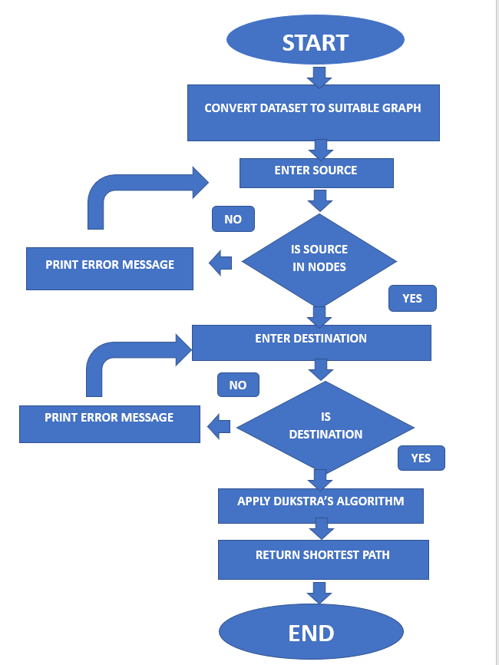
FLOW CHART

Slide 10
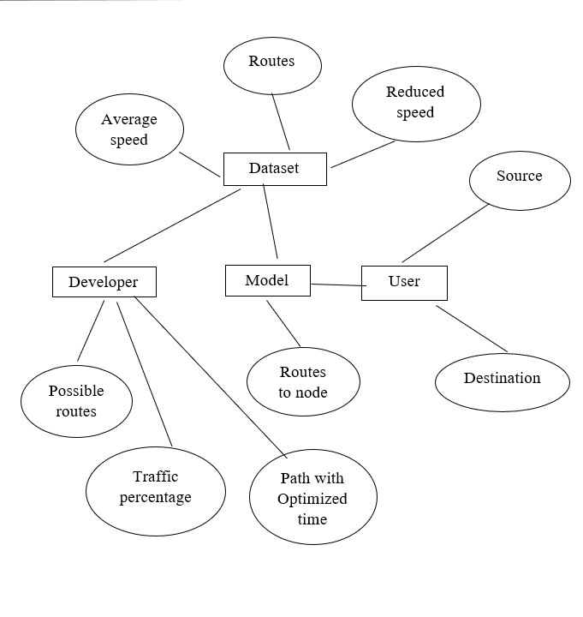
ER DIAGRAM

Slide 11
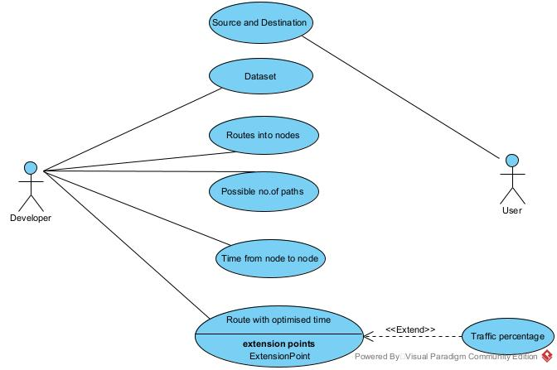
UML DIAGRAM
Fig: USE CASE DIAGRAM

Slide 12
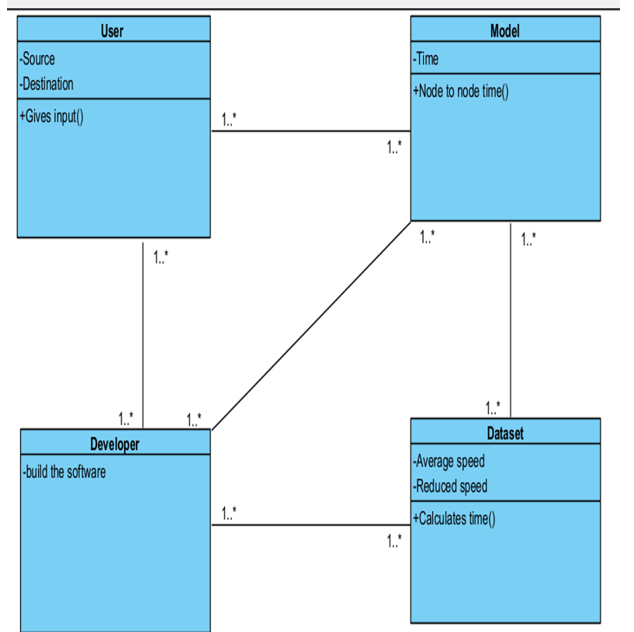
UML DIAGRAM
Fig: CLASS DIAGRAM

Slide 13
MODULES DESCRIPTION
Graph Algorithm
Dijkstra’s Algorithm
Time Algorithm

Slide 14
GRAPH ALGORITHM
This method is based on graph theory, where the road network is first converted into graph with nodes and edges.
Here, nodes represent the area and the edge represents the time required to travel through.
The edges are given with different weight i.e. the distance and the traffic percentage in that route.

Slide 15
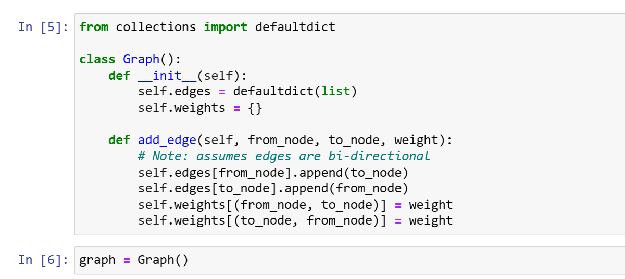
GRAPH ALGORITHM
Fig: GRAPH ALGORITHM

Slide 16
DIJKSTRA’S ALGORITHM
Dijkstra’s algorithm is used to find the shortest path among all the available paths.
This algorithm uses the weights of the edges to find the path that minimizes the total distance between the source node and all other nodes.

Slide 17
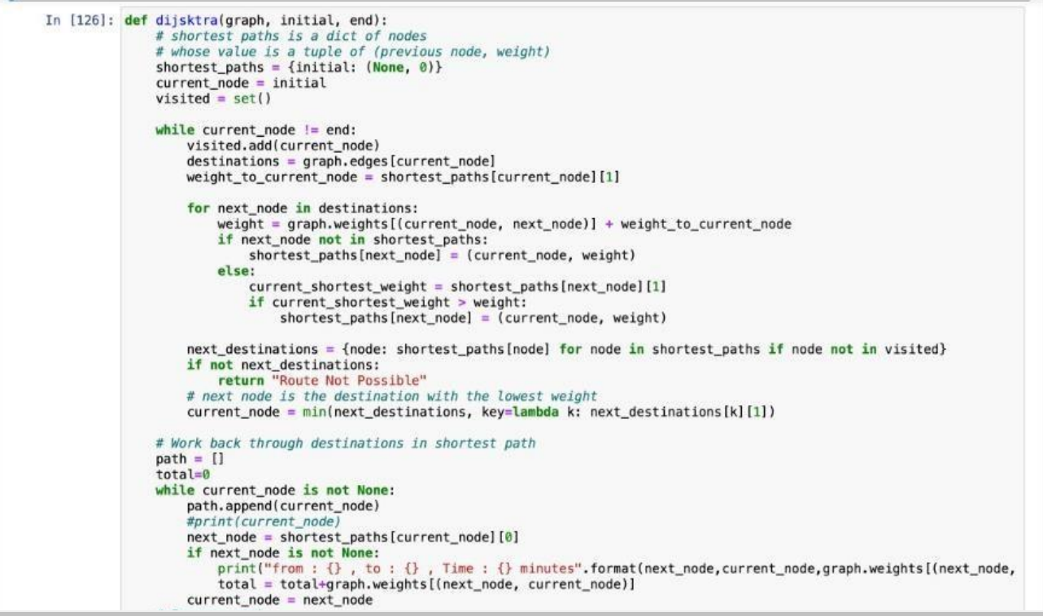
DIJKSTRA’S ALGORITHM
Fig: DIJKSTRA’S ALGORITHM

Slide 18
TIME ALGORITHM
The time taken to move from one location to another is obtained from the calculation of the distance and weightage of the traffic in that route along with the standard average speed calculation.
T = D / (S – ((S*P)/100))
D - Distance between two nodes
P - Percentage of traffic flow
S - Average speed
T – Time taken to reach destination

Slide 19
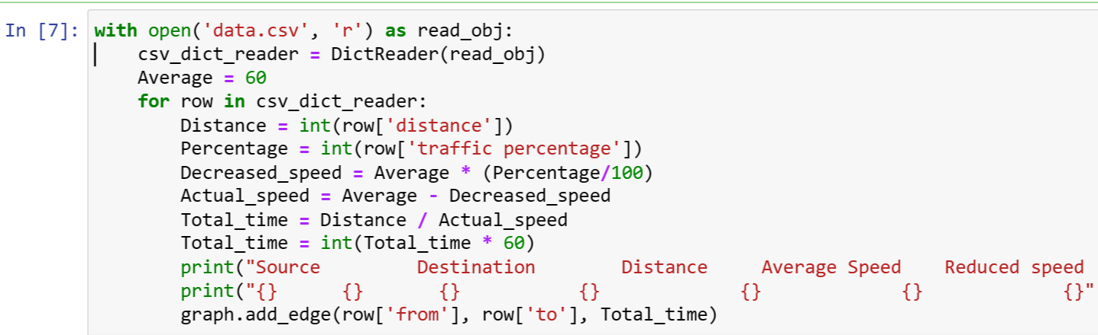
TIME ALGORITHM
Fig: TIME ALGORITHM

Slide 20
RESULT
INPUT
Input given by the user:
Source: 28 AVE.
Des:PITKIN AVE
OUTPUT
From : NORTON ST , To : PITKIN AVE ,
Time : 23 minutes
From : QUEENS BLVD , To : NORTON ST,
Time : 17 minutes
From : 28 AVE , To : QUEENS BLVD , Time : 31 minutes
Total Time: 71 minutes
Source : 28 AVE
QUEENS BLVD
NORTON ST
Destination : PITKIN AVE.

Slide 21
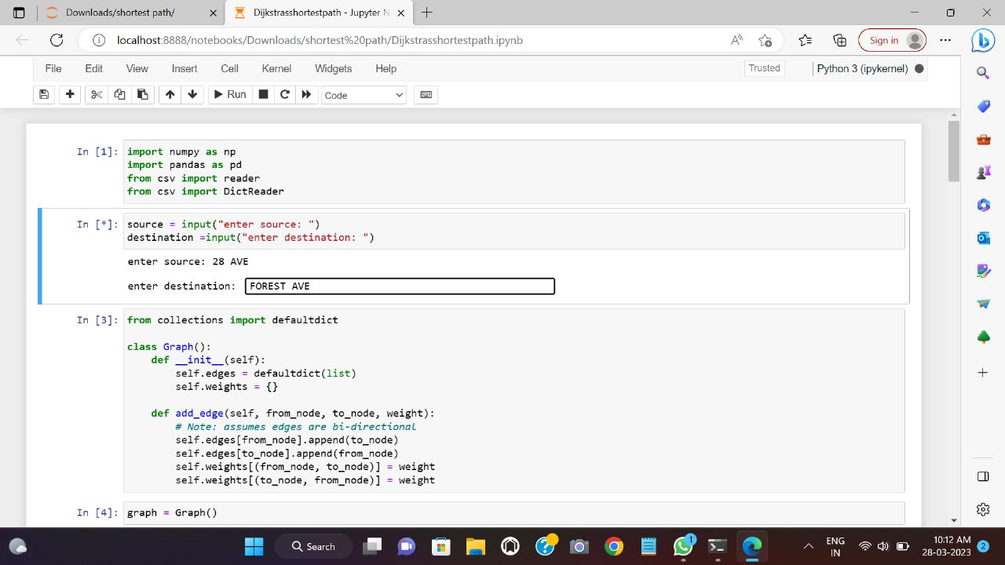
SCREENSHOTS
Fig:INPUT

Slide 22
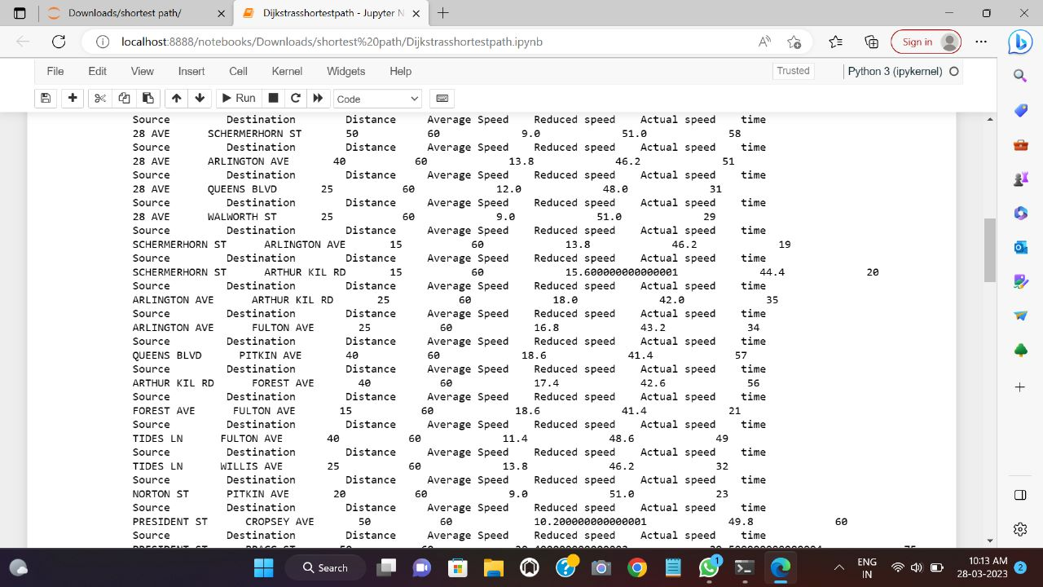
SCREENSHOTS
Fig: OUTPUT OF TIME ALGORITHM

Slide 23
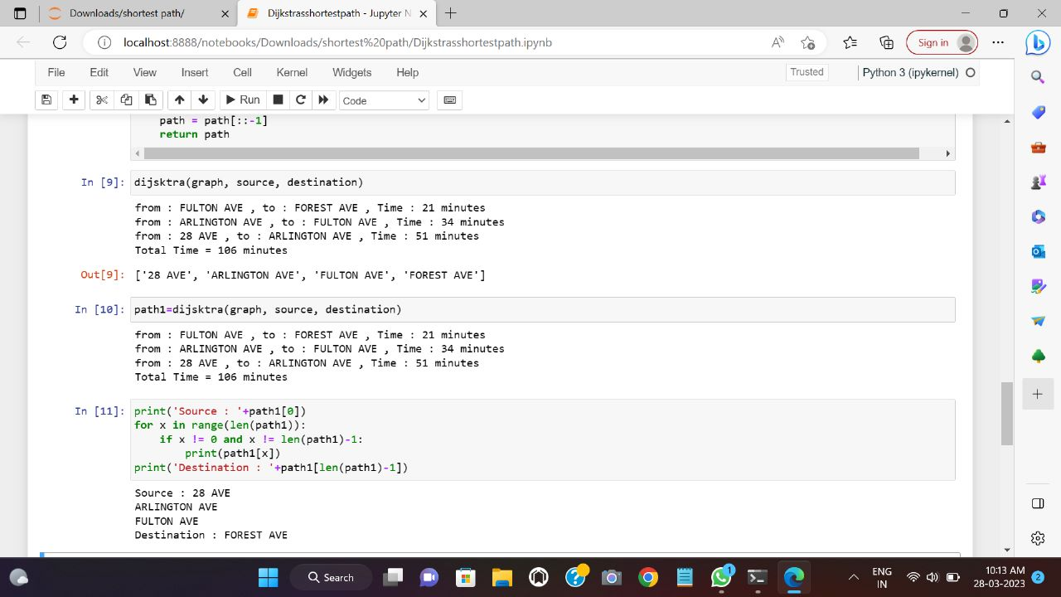
SCREENSHOTS
Fig: OUTPUT OF FINAL ALGORITHM

Slide 24
CONCLUSION
In conclusion, it is evident that in the current world with developing technology, efficiency and reliability are critical.
The system developed shows that the fastest route from one point to another can be determined with a suitable algorithm and also helps to save many lives by its efficient traffic flow control methodology.

Slide 25
REFERENCES
[1] Noor Afiza Mat Razali, Nuraini Shamsaimon, Khairul Khalil Ishak. Traffic flow prediction using machine learning and deep learning. Journal of Big Data volume 8, Article number: 152 (2021), Dec 04, 2021.
[2] S.Neelakandan, M. A. Berlin, Sandesh Tripathi, V.Brindha Devi. IoTbased traffic prediction and traffic signal control system for smart city.ResearchGate,19 May 2021
[3] Idriss Idrissi, Mostafa Azizi, Omar Moussaoui. IoT security with Deep Learning-based Intrusion Detection Systems. 4th ICDS , 21-23, October 2020.
[4] Guangjie Han, Hao Wang, Mohsen Guizani, Sammy Chan. KCLP: A kMeans Cluster-Based Location Privacy Protection Scheme in WSNs for IoT. IEEE Wireless Communications, December 2018.

Slide 26
BASE PAPER LINK
https://drive.google.com/file/d/1O0Y05tLg_wd_IogAHI3QMMVihk6WiZuX/view?usp=sharing

Slide 27

THANK YOU

